Slide 1
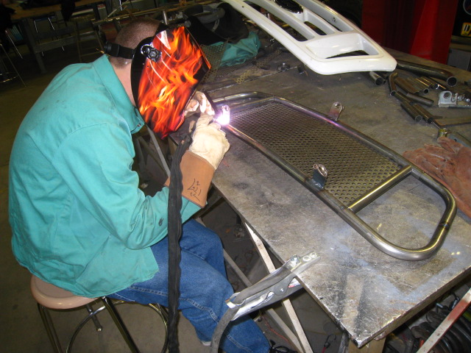
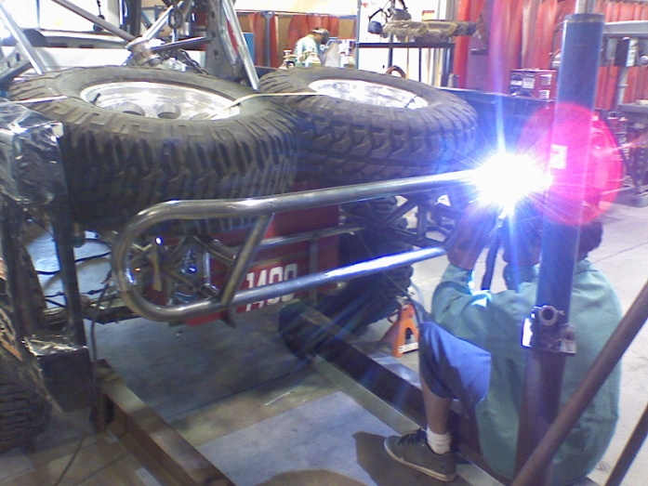
GTAW
Gas Tungsten Arc Welding
(a.K.A. “TIG”)

Slide 3
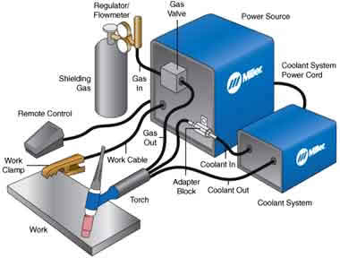

Slide 4
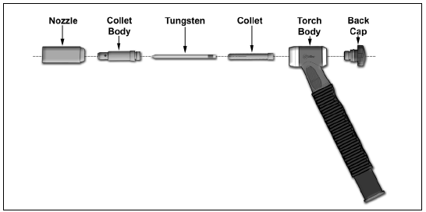
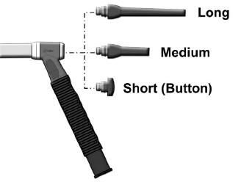
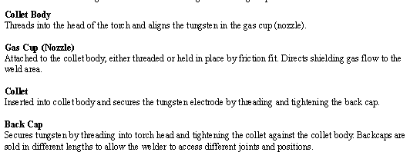

Slide 8
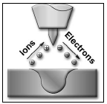
For steel and
stainless Steel

Slide 9
Preparing a tungsten for DC Welding

Slide 10
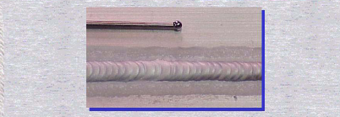
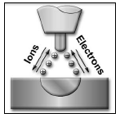
For
aluminum

Slide 11
Preparing a tungsten for ac Welding

Slide 12
-Argon
-Helium

