Slide 1
Working Drawing and Welding Symbols
ASTE 3030

Slide 2
Objectives
Define working drawing, print, orthographic projection, and mechanical drawing
Create a working drawing of your project
Differentiate and use different types of lines used on a drawing
Identify welding symbols
Identify welding joints and positions
Compare and contrast welding positions and joints

Slide 3
Terms
Mechanical Drawing
A drawing done with the aid of instruments
Working Drawing
Drawings that are used to produce a part or product. They may be detail or assembly drawings
They must have enough views of an object to show the necessary details, edges, and contours for construction purposes
Print
Copy made of the original drawing

Slide 4
Terms
Orthographic Projection
A drawing that shows separate views of an object, usually the front, top, and end.
Oblique Drawing
A representation of an object with one axis vertical, one axis horizontal, and the third axis at a convenient angle. Only the front face is the true shape of the object.

Slide 6
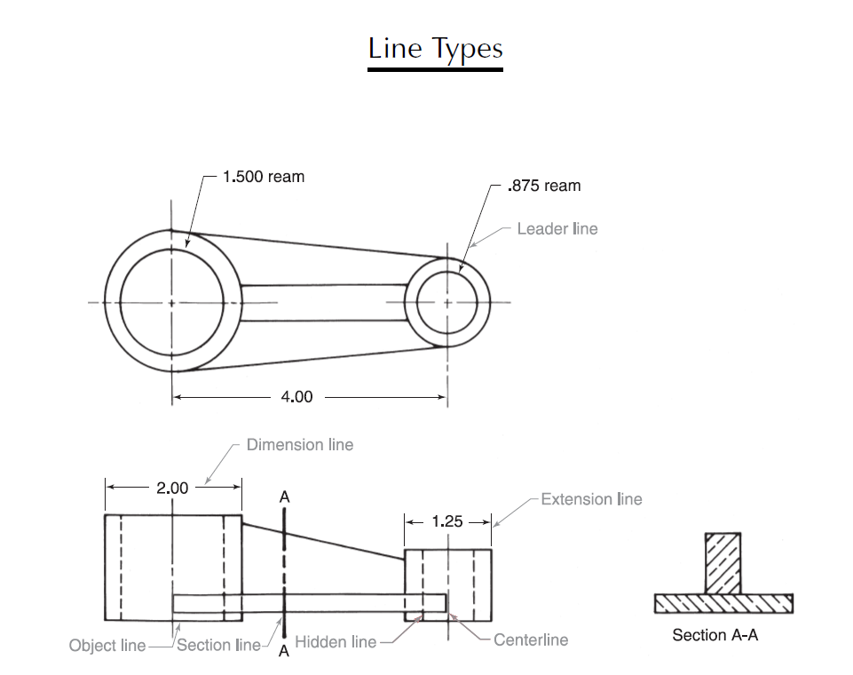
Leader line
Dimension line
Extension line
Object line
Centerline
Section line
Hidden line

Slide 7
Joint symbols
AWS
AWS

Slide 8
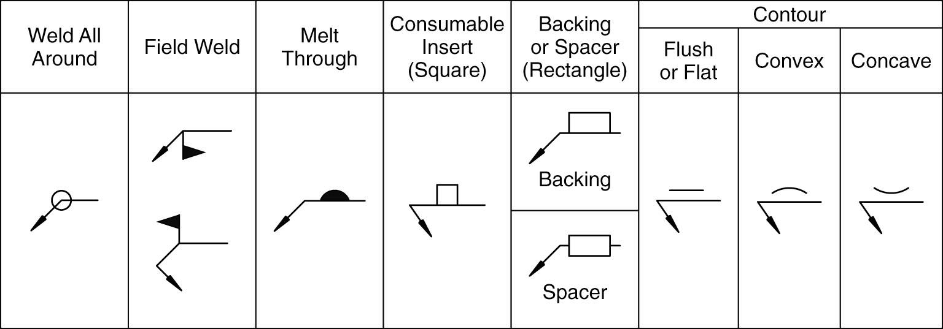
Joint symbols
AWS

Slide 9
Welding symbol

Slide 10
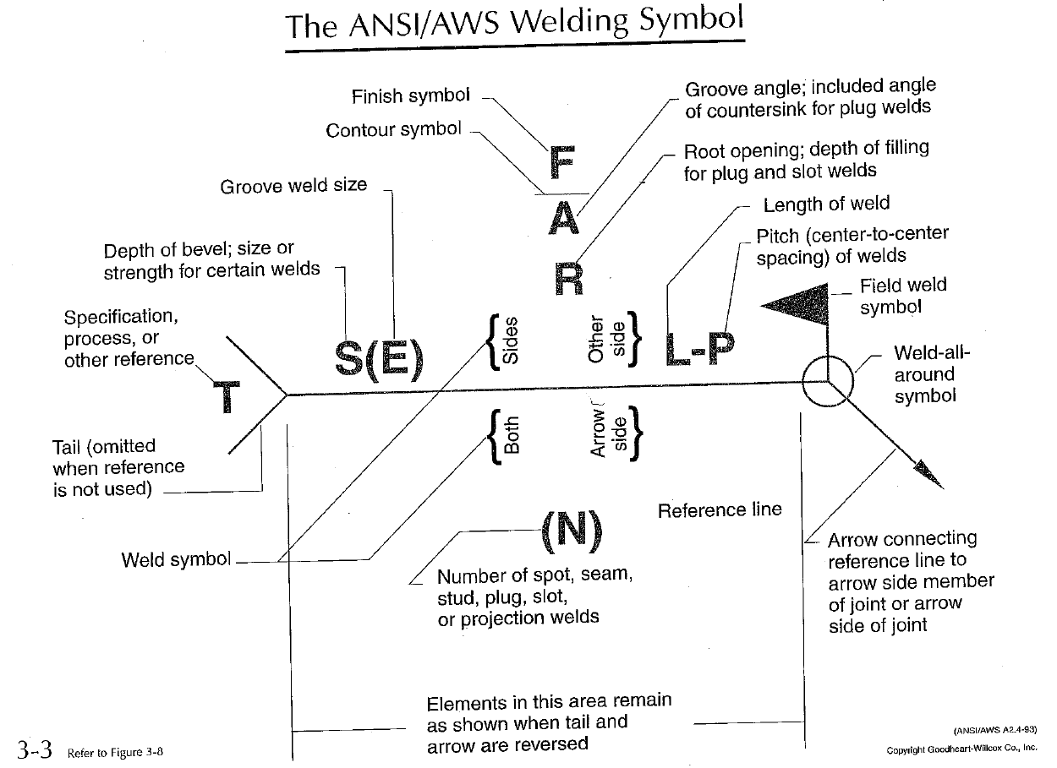

Slide 11
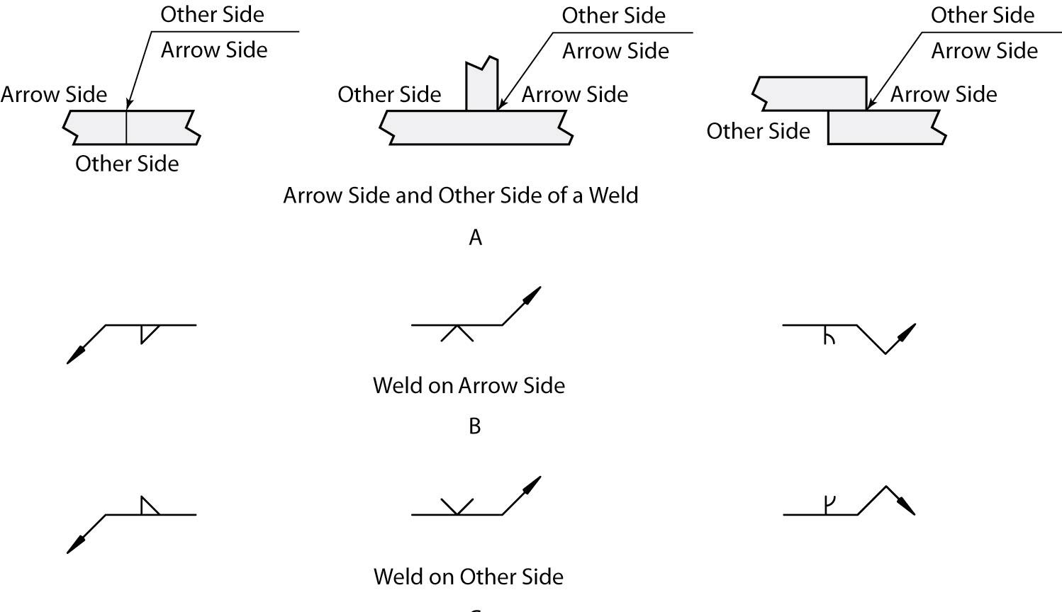

Slide 12
Fillet weld
Fillet weld triangular-shaped weld placed on the joint
Fillet weld symbol triangular in shape
Vertical line of fillet weld symbol always drawn to left of symbol
Size always shown to left of symbol and length to right of symbol
No length given, then weld should run full length of joint

Slide 13
Fillet Example

Slide 14
Fillet weld length and pitch

Slide 15
Groove Weld
Place in a joint (fill a void)
Used to make butt joints, but can be used to make other types of joints
Double bevel
One of joint members has bevel on both sides and joint is to be welded from both sides
V shape

Slide 16
V-Groove Weld

Slide 17
Double V-Groove

Slide 18
Contour Symbol and Letters Which Indicate Finishing Method

Slide 19
Supplementary Symbols
American Welding Society, p. 89.

Slide 20
Nondestructive Examination Method Letter Designations
Examination method Letter designation
Acoustic emission AET
Electromagnetic ET
Leak LT
Magnetic particle MT
Neutron radiographic NRT
Penetrate PT
Proof PRT
Radiographic RT
Ultrasonic UT
Visual VT
American Welding Society

Slide 21
